Slide 1

EDA for Facebook Data
By
Devender Kumar

Slide 2
Index
Introduction
Project Introduction
Data Understanding
Data Description
Data Analyzing
Data Cleaning
Data Visualization using EDA
Data Conclusion

Slide 3
Introduction
Exploratory Data Analysis:
Exploratory Data Analysis is structuring data set which includes loading, inspecting, wrangling, exploring, and drawing conclusions from data.
Steps to approach the data:
1. Problem defining
2. Data understanding
3. Data Analyzing/Profiling
4. Data Cleaning
5. Data Visualization
5. Drawing conclusions.
Data Source used: Facebook Data
The Facebook website was launched on Feb 4th 2004 by Mark Zuckerberg along with few fellow of Harvard college students and roommates.
Facebook is a social networking website where people use it for:
1. Connecting and Communicating with friends over all the world
2. Sending Friend Requests.
3. Posting vedios/Pictures/likes/comments
4. Advertising ……………….etc.

Slide 4


Project Introduction
Purpose:
Understand the Data given in the file facebook.csv.
To analyze the user behaviors and their demographics of using Facebook .
Plot some EDA patterns for drawing conclusions from the data given .

Slide 5
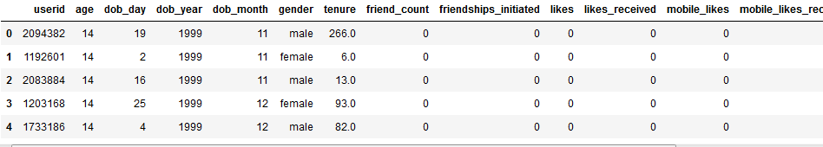
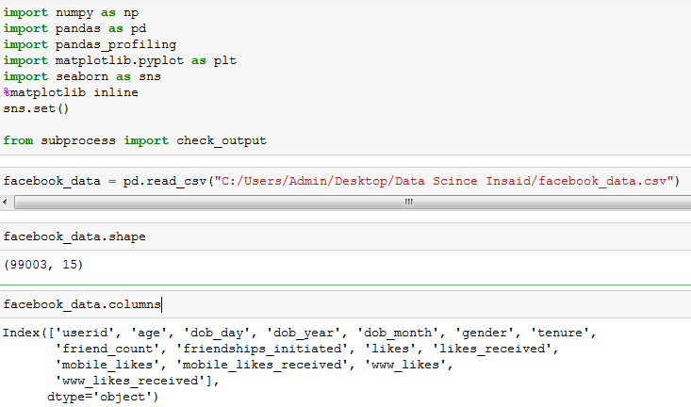
Data Understanding
Importing facebook.csv:

Slide 6
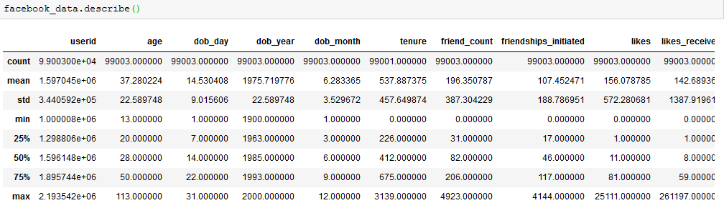
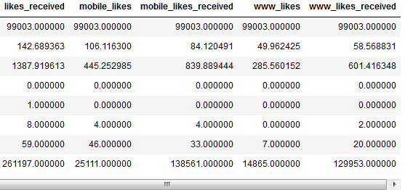
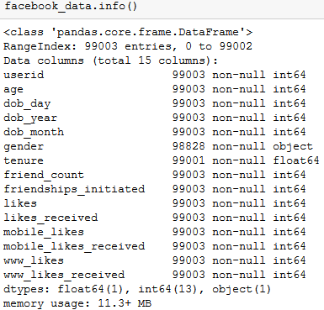
Data Description
We use describe() function to describe the Facebook dataset.

Slide 7
Data Analyzing
Padas profiling :
pandas profiling we will find which columns of our dataset need pre-processing
In pre-processing we will deal with erroneous and missing values of columns.
It can be done pre profiling and post profiling.
Output file:

Slide 8
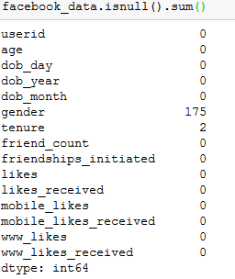
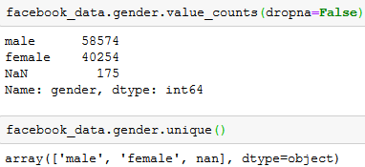
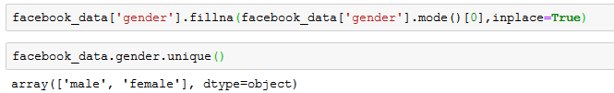
Data Cleaning
The null values can be replaced by most occurring value (mode) or can be dropped from the table .
Replacing Null values by mode in Tenure column:
Replacing Null values by mode in Gender column:

Slide 9
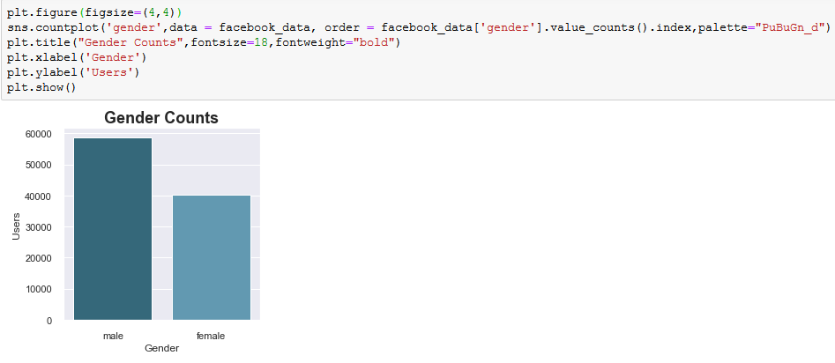
Data Visualization(EDA)
Data visualization helps to understand the problem better by representing the information in the form of a chart, diagram, pictures etc…
Plotting data using univariate, bivariate and multivariate graphs.
Gender Vs. Users:

Slide 10
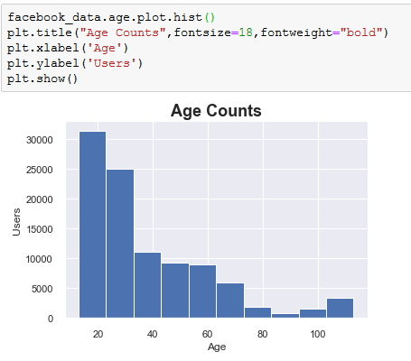
Data Visualization(EDA)
Which age group people use facebook more???

Slide 11
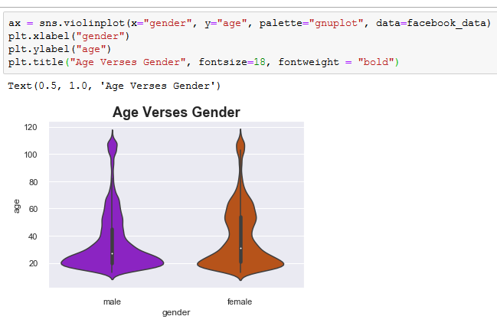
Data Visualization(EDA)
Age Vs. Gender :

Slide 12
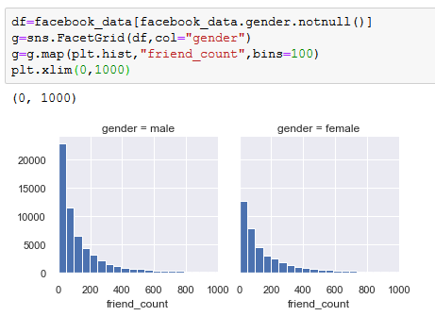
Data Visualization(EDA)
Which gender has more friend count???

Slide 13
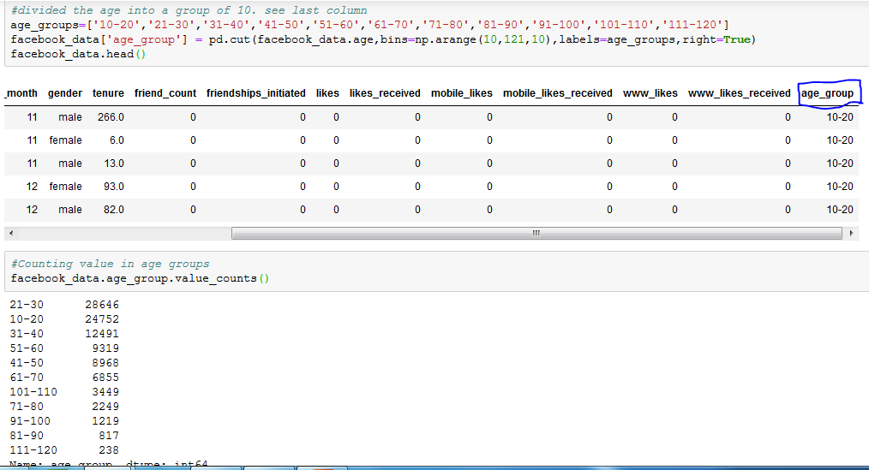
Data Visualization(EDA)
Adding new column age group:

Slide 14
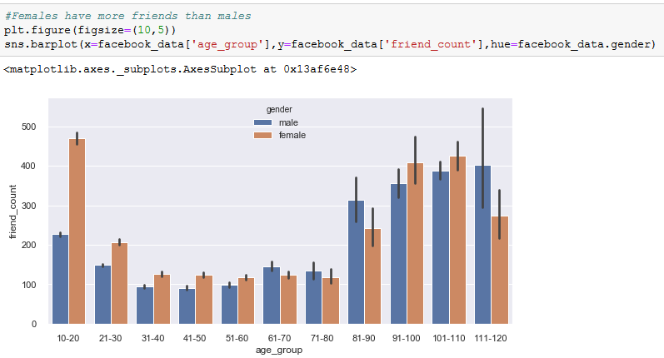
Data Visualization(EDA)
Which gender had more friend count according to their ages???

Slide 15
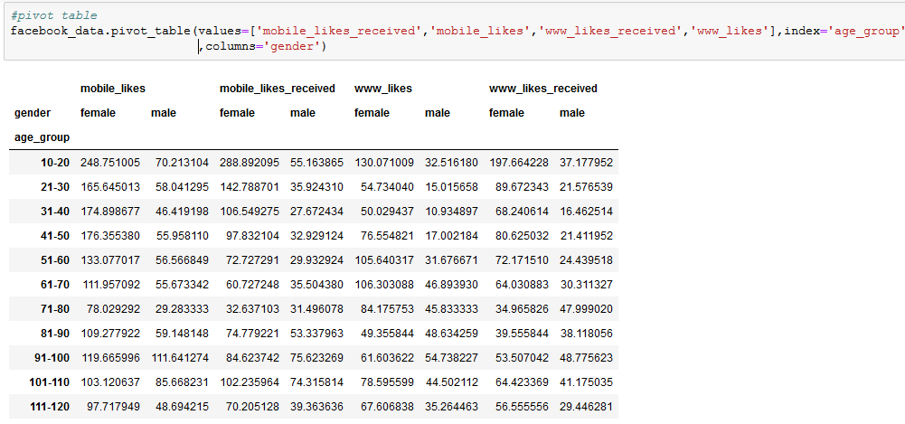
Data Visualization(EDA)
Pivot table defining total likes according to gender and age group:

Slide 16
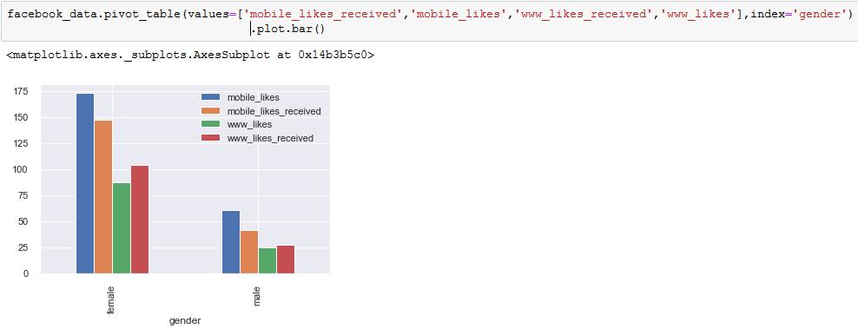
Data Visualization(EDA)
How many total likes received by gender according to category of likes???

Slide 17
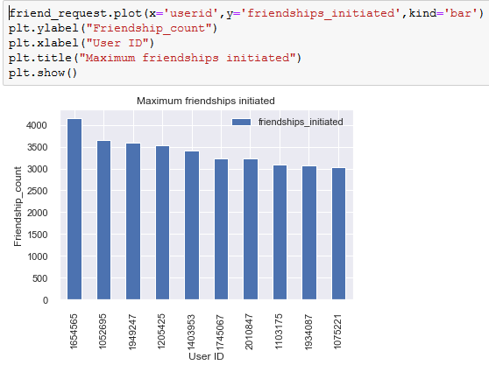
Data Visualization(EDA)
What is the friend count for sample User ID ???

Slide 18
Data Conclusions
Male users are more compared to females who sign up for facebook.
20-30 age group people are using facebook more.
Friends count for males is high compared to females.
Female has more friends for age group 10-20 years.
Likes are high for female gender.
Mobile Likes received are high compare to website likes received.

Slide 19

Thank You

Slide 20
Context
https://raw.githubusercontent.com/insaid2018/Term1/master/Data/Projects/facebook_data.csv
https://github.com/DevenderKumar090/Facebook-Data-EDA-Insaid/blob/master/PROJECT_FACEBOOK%20DATA.ipynb
https://github.com/DevenderKumar090/Facebook-Data-EDA-Insaid/blob/master/facebook_before_preprocessing.html
https://github.com/DevenderKumar090/Facebook-Data-EDA-Insaid/blob/master/Facebook%20Data%20PPT%20Vedio.mp4

